Slide 1
Week 9: Examples of Knowledge management systems
Chapter 13 – Chapter 16
Becerra-Fernandez, et al. -- Knowledge Management 1/e -- © 2004 Prentice Hall

Slide 2
Outline
Knowledge Discovery Systems: Chapter 13
Knowledge Capture Systems: Chapter 14
Knowledge Sharing Systems: Chapter15
Knowledge Application Systems: Chapter 16
Becerra-Fernandez, et al. -- Knowledge Management 1/e -- © 2004 Prentice Hall

Slide 3
Knowledge Discovery Systems
Synthesis of new knowledge through socialization with other knowledgeable persons
Discovery by finding interesting patterns in observations, typically embodied in explicit data
Becerra-Fernandez, et al. -- Knowledge Management 1/e -- © 2004 Prentice Hall

Slide 4
Case Study (1)
An application of Rule Induction to real estate appraisal systems
  In this case, we seek specific knowledge that we know can be found in the data in databases, but which can be difficult to extract.
  Procedure: create a decision tree:
    Data preparation and preprocessing
    Tree construction
    House pruning: use heuristics to remove deviated leaf nodes from a certain group
    Paired leaf analysis: differences in worth between two sibling leaves is directly caused by difference in their values of the critical attribute
Becerra-Fernandez, et al. -- Knowledge Management 1/e -- © 2004 Prentice Hall

Slide 5
Case Study: An application of Rule Induction to real estate appraisal systems
Attribute
Induction Results
Expert Estimate
Difference
Living Area
$15 - $31
$15 - $25
0 - 2.4%
Bedrooms
$4311 - $5212
$2500 - $3500
49 - 72%
Bathrooms
$3812 - $5718
$1500 - $2000
154 - 186%
Garage
$3010 - $4522
$3000 - $3500
0.3 - 29%
Pool
$7317 - $11697
$9000 - $12000
2.5 - 19%
Fireplace
$1500 - $4180
$1200 - $2000
25 - 109%
Year Built
1.2 - 1.7%
1.0 - 1.2%
20 - 42%
Summary of Induction Results
Becerra-Fernandez, et al. -- Knowledge Management 1/e -- © 2004 Prentice Hall

Slide 6
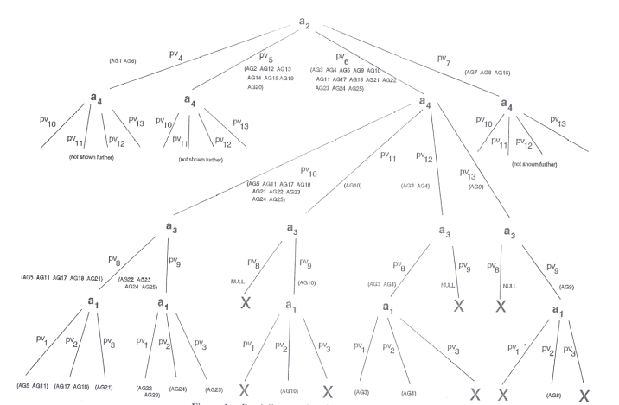
Case Study: An application of Rule Induction to real estate appraisal systems
Partial Decision Tree Results for Real Estate Appraisal
Becerra-Fernandez, et al. -- Knowledge Management 1/e -- © 2004 Prentice Hall

Slide 7
Case Study (2)
An application of Web Content mining to Expertise Locator Systems
  NASA Expert Seeker Web Miner
  A KM system that locates experts based on published documents requires:
      Automatic method for identifying employee names.
      A method to associate employee names with skill keywords embedded in those documents.
Becerra-Fernandez, et al. -- Knowledge Management 1/e -- © 2004 Prentice Hall

Slide 8
Knowledge
Capture Systems
Knowledge capture systems support process of eliciting explicit or tacit knowledge from people, artifacts, or organizational entities
Rely on mechanisms and technologies to support externalization (converting tacit knowledge into explicit forms) and internalization (conversion of explicit knowledge into tacit knowledge)
Becerra-Fernandez, et al. -- Knowledge Management 1/e -- © 2004 Prentice Hall

Slide 9
Knowledge Representation through the use of Concept Maps
Concepts, enclosed in circles or boxes are perceived regularities in events or objects designated by a label
Two concepts connected by a linking word to form a proposition, a semantic unit or unit of meaning
Vertical axis expresses a hierarchical framework for organizing the concepts
Becerra-Fernandez, et al. -- Knowledge Management 1/e -- © 2004 Prentice Hall

Slide 10
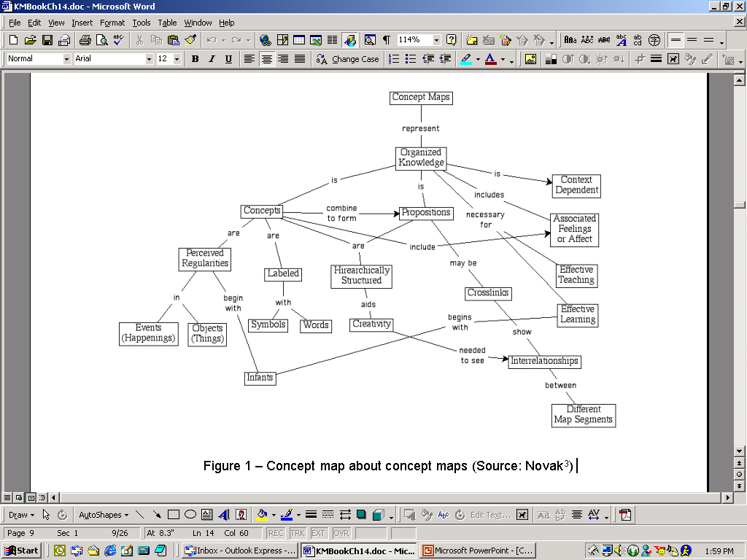
Concept Map about Concept Maps: meta representation
Becerra-Fernandez, et al. -- Knowledge Management 1/e -- © 2004 Prentice Hall

Slide 11
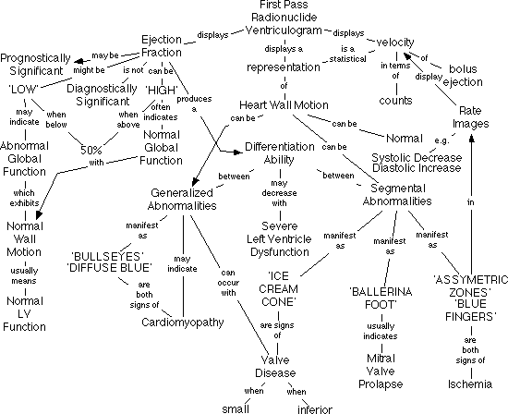
A Concept Map Segment from Nuclear Cardiology Domain
Becerra-Fernandez, et al. -- Knowledge Management 1/e -- © 2004 Prentice Hall

Slide 12
Knowledge Capture Systems: CmapTools
To capture knowledge resulting in context rich knowledge representation models to be viewed and shared through the Internet
Facilitate navigation with concept maps
Serve as the browsing interface to a domain of knowledge
Icons below the concept nodes provide access to auxiliary information
Linked media resources and concept maps can be located anywhere on the Internet
Browser provides a window showing the hierarchical ordering of maps
Becerra-Fernandez, et al. -- Knowledge Management 1/e -- © 2004 Prentice Hall

Slide 13
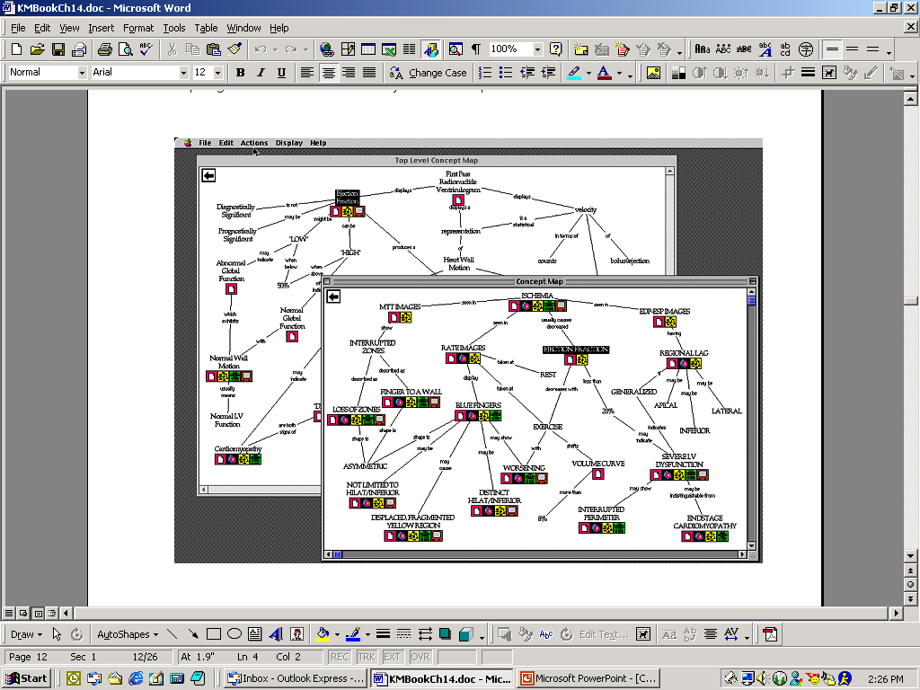
Segment from Nuclear Cardiology using CmapTools
Becerra-Fernandez, et al. -- Knowledge Management 1/e -- © 2004 Prentice Hall

Slide 14
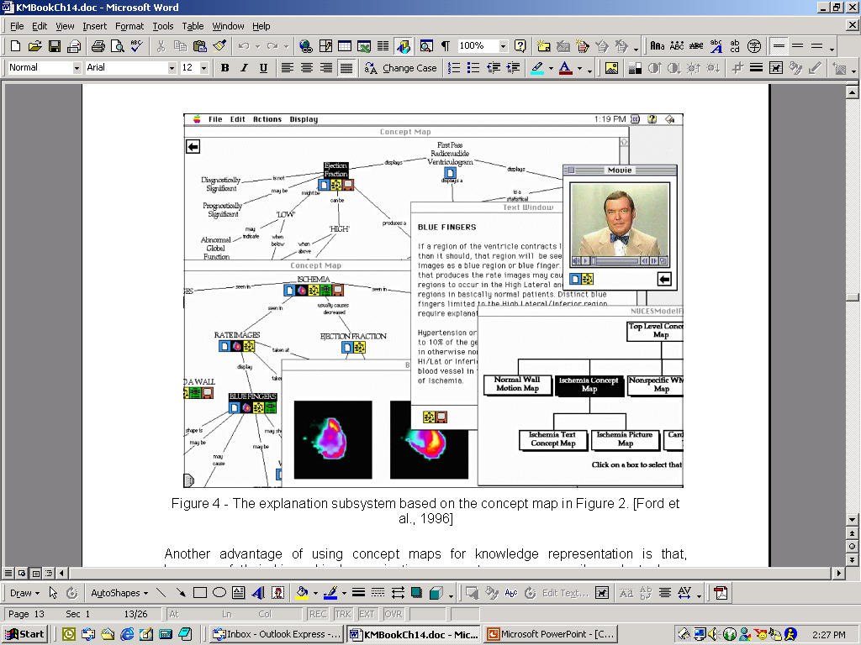
Explanation Subsystem using CmapTools
Becerra-Fernandez, et al. -- Knowledge Management 1/e -- © 2004 Prentice Hall

Slide 15
Knowledge
Sharing Systems
A knowledge sharing system helps to organize and distribute an organization's corporate memory so that it can be accessed even after the original sources of knowledge no longer remain within the organization.
Systems that enable members of an organization to acquire tacit and explicit knowledge from each other.
Becerra-Fernandez, et al. -- Knowledge Management 1/e -- © 2004 Prentice Hall

Slide 16
Expertise-Locator Knowledge Sharing Systems
Goal: to catalog knowledge competencies, including information not typically captured by human resources systems, in a way that could later be queried across the organization to help locate intellectual capital.
Significant challenge in the development of ELS, knowledge repositories, and digital libraries deals with the accurate development of knowledge taxonomies.
  Taxonomies, also called classification or categorization schemes, are considered to be knowledge organization systems that serve to group objects together based on a particular characteristic.
Becerra-Fernandez, et al. -- Knowledge Management 1/e -- © 2004 Prentice Hall

Slide 17
Case Study (1)- SAGE
The purpose of Searchable Answer Generating Environment (SAGE) is to create a searchable repository of university experts in the State of Florida.
Each university has a database of their researchers.
The system assumes that the researchers who successfully obtained funded research grants are experts in their fields.
www.sage.fiu.edu
Becerra-Fernandez, et al. -- Knowledge Management 1/e -- © 2004 Prentice Hall

Slide 18
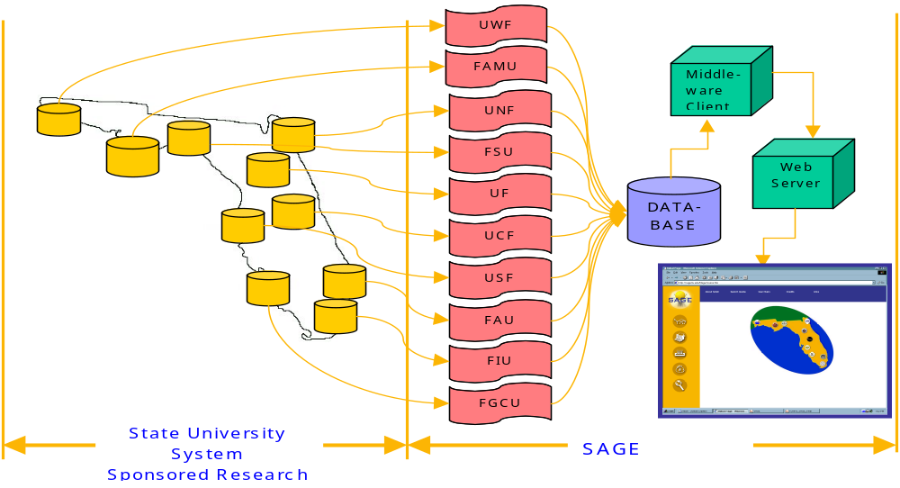
SAGE Architecture
Becerra-Fernandez, et al. -- Knowledge Management 1/e -- © 2004 Prentice Hall

Slide 19
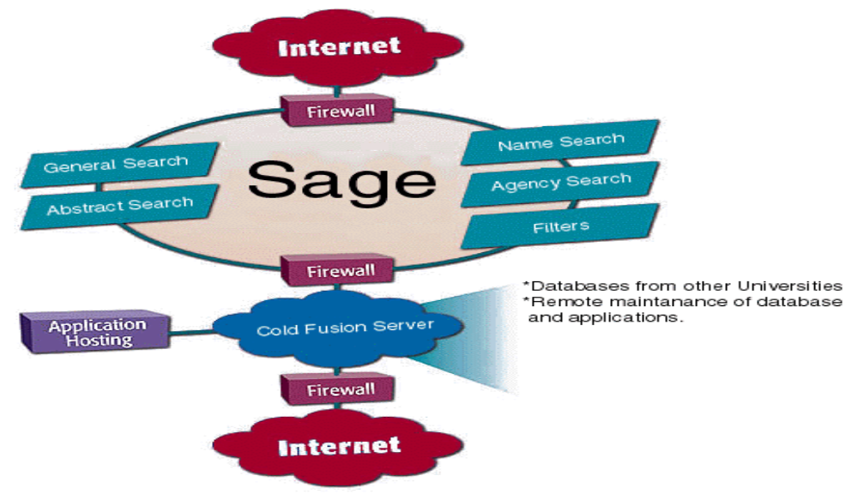
Technologies to Implement SAGE
Becerra-Fernandez, et al. -- Knowledge Management 1/e -- © 2004 Prentice Hall

Slide 20
Case Study (2) – Expert Seeker
Expert Seeker is an organizational expertise-locator KMS used to locate experts at NASA.
The main difference between Expert Seeker and SAGE is that the former searches for expertise at NASA (KSC and GSFC), while the latter is on the Web and seeks expertise at various universities.
Expert Seeker builds a profile for each expert that can be easily searched via a web-based interface.
Becerra-Fernandez, et al. -- Knowledge Management 1/e -- © 2004 Prentice Hall

Slide 21
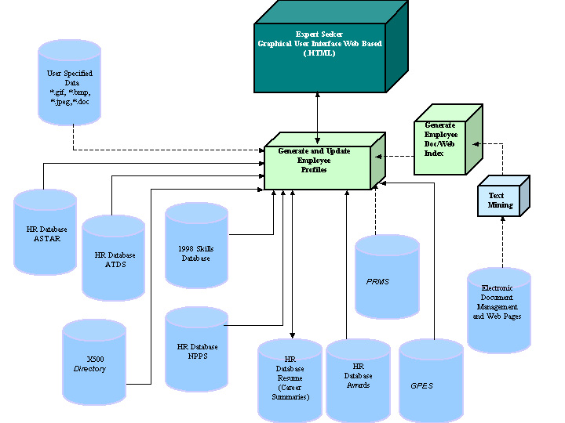
Expert Seeker Architecture
Becerra-Fernandez, et al. -- Knowledge Management 1/e -- © 2004 Prentice Hall

Slide 22
Knowledge Application Systems
In Knowledge application systems explicit or tacit knowledge is utilized to guide decisions and actions
In knowledge application, the party that makes use of the knowledge does not necessarily need to comprehend it!
Becerra-Fernandez, et al. -- Knowledge Management 1/e -- © 2004 Prentice Hall

Slide 23
Case Study (1): SOS Advisor
The SBIR/STTR Online System (SOS) Advisor
Web-based expert system
identify potential applicants to the Small Business Innovation Research (SBIR) and Small Business Technology Transfer Research (STTR) programs
optimize the time required to examine the potential eligibility of companies seeking SBIR/STTR funding.
Users only need to click yes or no to answer the 10 questions that frame the eligibility criteria.
Becerra-Fernandez, et al. -- Knowledge Management 1/e -- © 2004 Prentice Hall

Slide 24
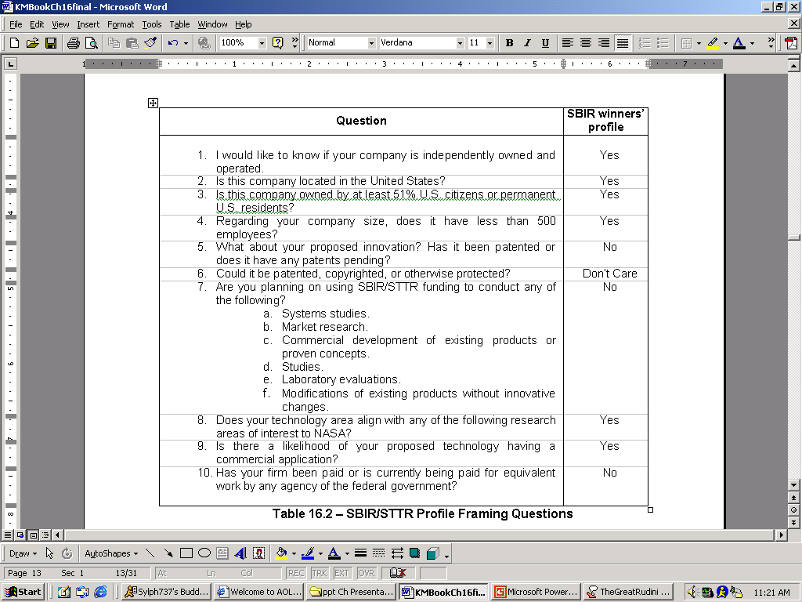
Case Study (1): SOS Advisor
Becerra-Fernandez, et al. -- Knowledge Management 1/e -- © 2004 Prentice Hall

